Slide 1

Automation of the Testbed Creation for Research in Security Analytics and Network Security Areas
Aragats Amirkhanyan
Internet-Technologies and Systems
Hasso Plattner Institute

Slide 2
Agenda
Motivation
Simulation of user behavior
Overview
Normal scenario
Abnormal scenario
Implementation
Security Lab Generator
Overview
OpenStack
Security Lab Generator based on OpenStack
Conclusion

Slide 3
Motivation
Common issues for research in security analytics and network security areas:
The absence of data
Test network environment Testbed
Simulation of actions

Slide 4
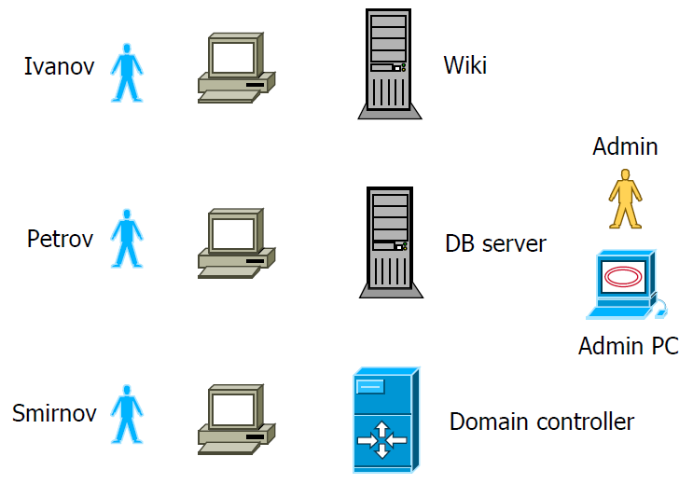
Simulation of user behavior - Overview
Description of the network:
4 client computers
Domain controller
Wiki server
Database server
Users:
Ivanov
Petrov
Smirnov
Admin

Slide 5
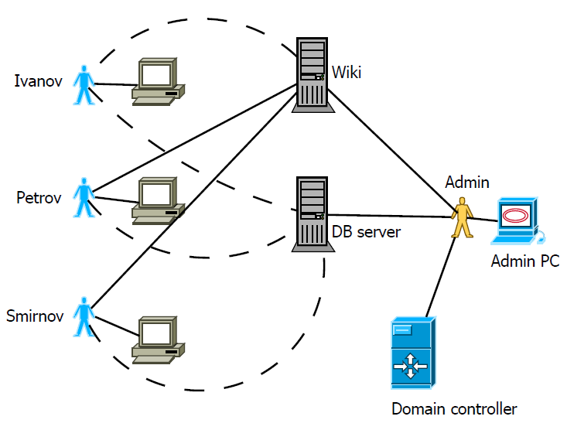
Simulation of user behavior - Normal scenario

Slide 6
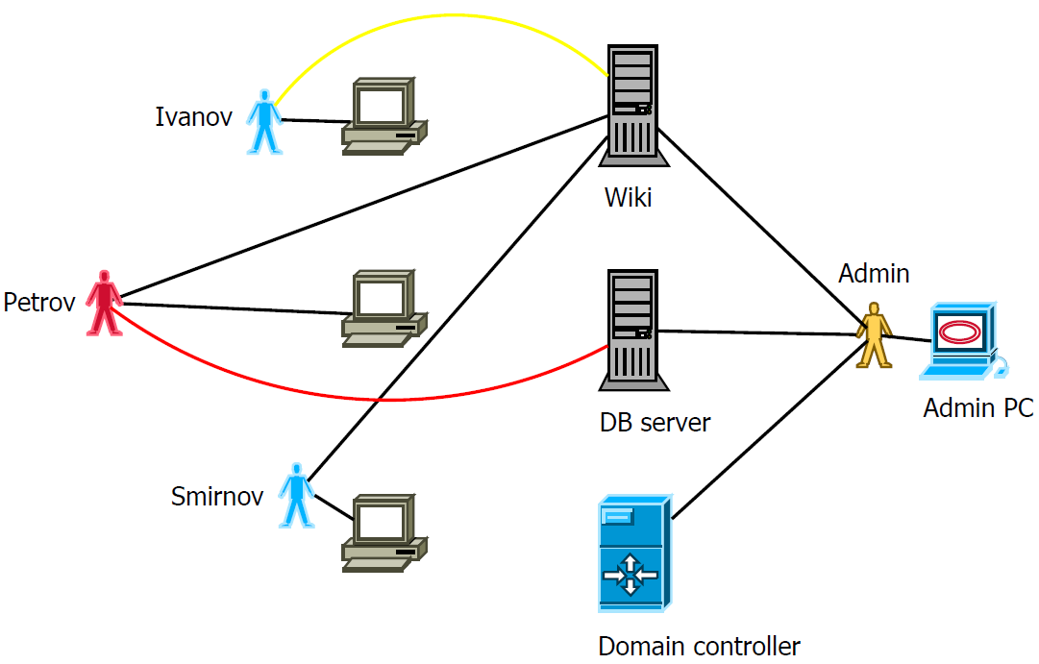
Simulation of user behavior - Abnormal scenario

Slide 7
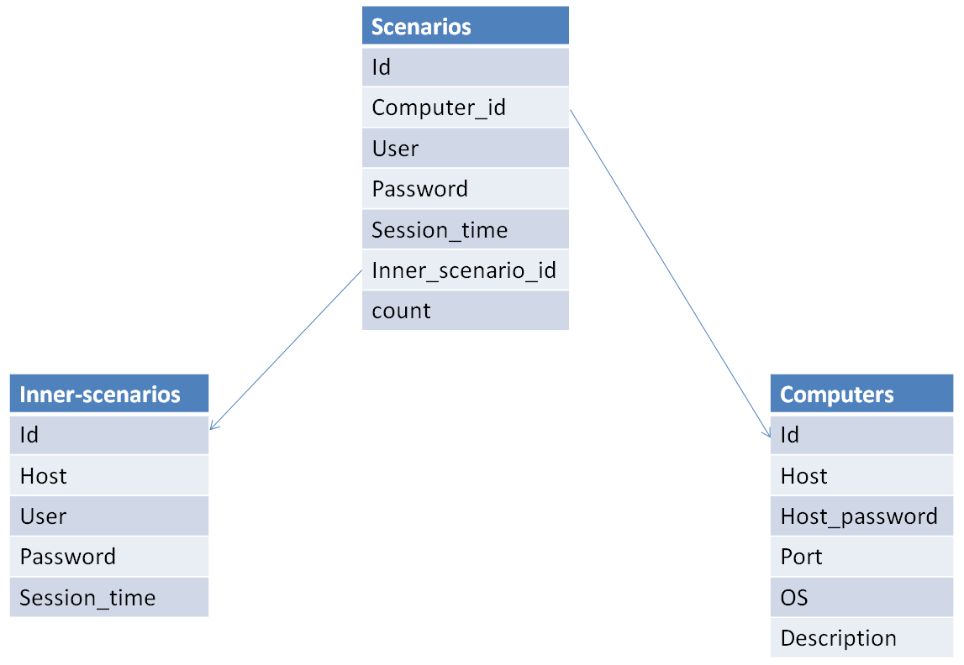
Simulation of user behavior - Implementation
FutureSOC ESXi server
VNC protocol
Python programming language
Vncdotool library
CSV

Slide 8
Agenda
Motivation
Simulation of user behavior
Overview
Normal scenario
Abnormal scenario
Implementation
Security Lab Generator
Overview
OpenStack
Security Lab Generator based on OpenStack
Conclusion

Slide 9
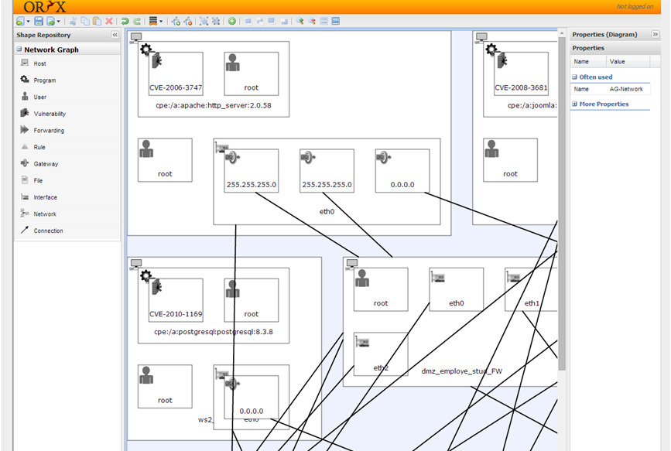
Security Lab Generator - Overview
Java + Grails
VirtualBox
Oryx
MySQL
PostgreSQL
MulVAL
XSB
GraphViz

Slide 10
Security Lab Generator - OpenStack
OpenStack is a free and open-source cloud infrastructure as a service.
Identity (Keystone)
Compute (Nova)
Image service (Glance)
Networking (Neutron)
Block Storage (Cinder)
Object Storage (Swift)
Dashboard (Horizon)
Orchestration (Heat)
Telemetry (Ceilometer)

Slide 11
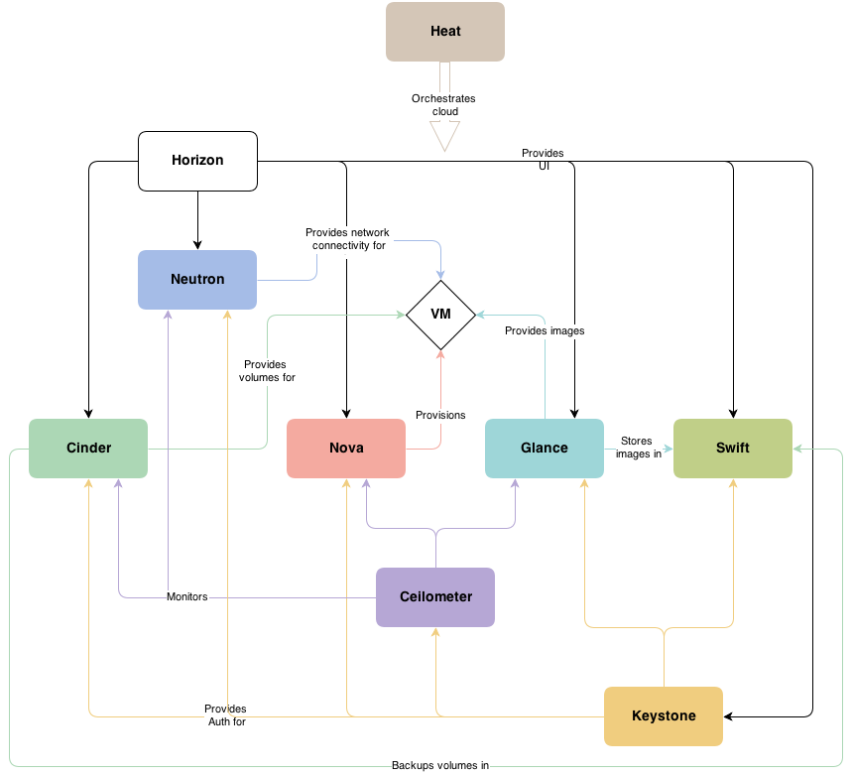
Security Lab Generator - OpenStack

Slide 12
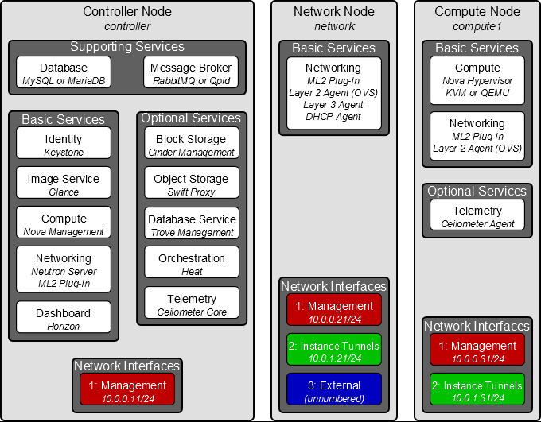
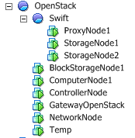
Security Lab Generator - OpenStack

Slide 13
Security Lab Generator - Security Lab Generator based on OpenStack
Motivation:
Wide functionality of IaaS
Automation of test network environments creation
Challenges:
Converting SLG XML into Amazon CloudFormation
Automation of creating specific images with vulnerable software applications

Slide 14
Conclusion and Future Work
Improve simulator of user behavior
Automation of creating specific images with vulnerable software applications
Converting SLG XML into Amazon CloudFormation

Slide 15
Thank you for your attention!
Aragats Amirkhanyan
Internet-Technologies and Systems
Hasso Plattner Institute

Slide 16


Slide 17


Slide 18


Slide 19
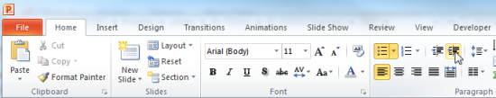
Explanations - Text layers
First text layer for running text.
Second level for bullet points
Third level for bullet points
Fourth level for bullet points
Fifth level for numberings
Sixth level for listings
Seventh text layer for Core Messages
In this template, we pre-formatted different text layers (as you can see on the right side). You don’t have to generate bullet points manually. By the way: Please avoid this!
To change from one text layer to the next, use the Increase / Decrease List Level buttons:

Slide 20
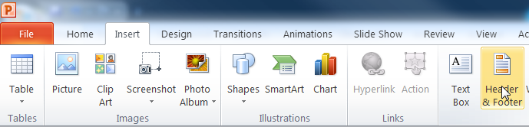
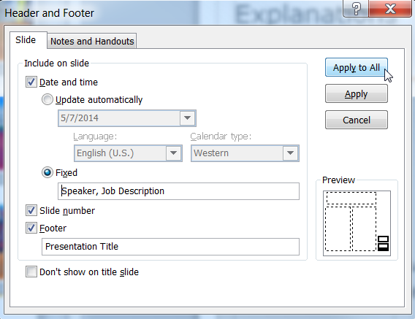
Explanations - Footer
You can insert or change your presentation‘s footer. Click on the Insert-tab | Header and Footer | After filling in your descriptions click on Apply to All.
Descriptions:
Activate date and time and write in:Speaker, Job Description
Activate the slide number.
Activate the footer and write in: Presentation Title
Don‘t use the template without the complete footer.

Slide 21
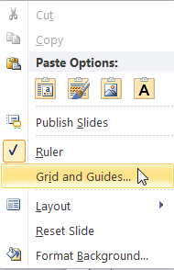
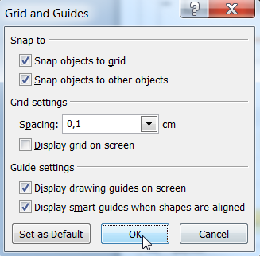
Explanations - Drawing guides
You can enable your guide-lines to align objects on the slide (View | Show | Select the option „Guides“)
Or hit the right mouse button outside the slide and go at „Grid and Guides…“

Slide 22
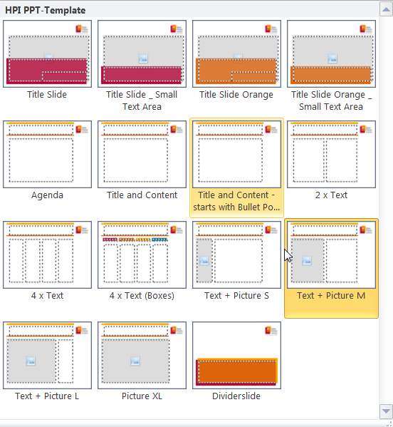
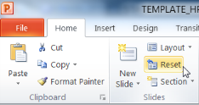
Explanations - Slide layouts
You can choose between different slide layouts. These pre-defined layouts gives you the oportunity to use text and visualisations just the right way.
To use these layouts:
Click on the Home-tab | New Slide or Layout | and choose one out of the layouts
Click „Reset“ to reset to the predefined slide layout.

